Slide 1
Zendesk Support

Slide 2
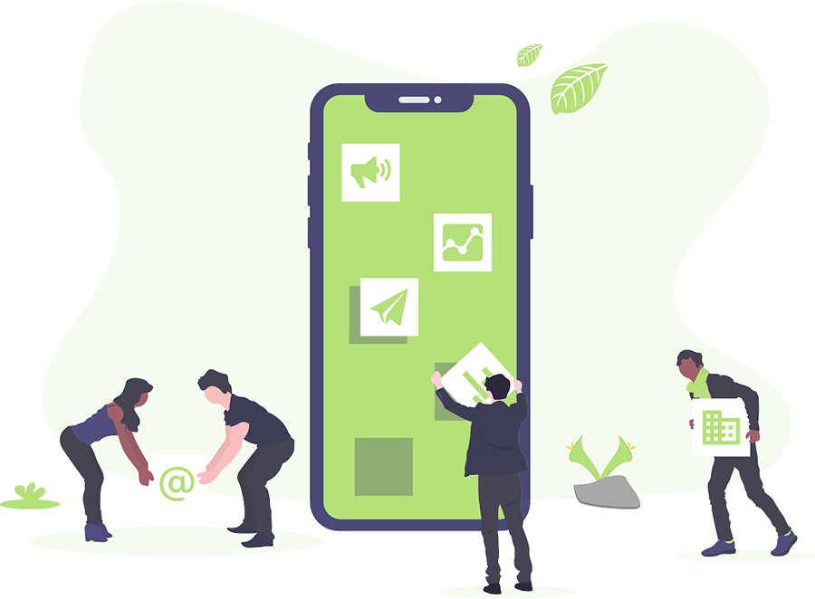
Support
Zendesk Support ticket based, and beautifully simple system for tracking, prioritising, and solving customer support tickets.

Slide 3

Default Email
When you set up Zendesk, you have one related email address : support@myaccount.zendesk.com known as default email address. Every communication with customers will be done with this email address (by default) but it can also be changed by connecting another email address which in our case is tech.support@quicbit.eu .
There can be only one default address in each zen desk account.

Slide 4
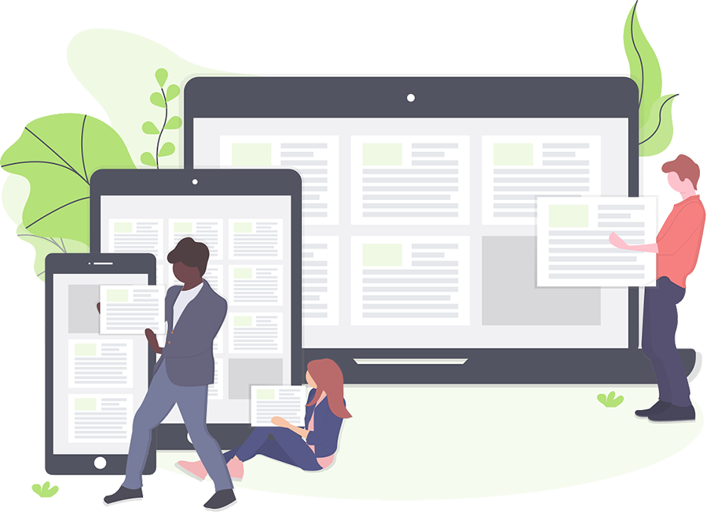
Zendesk Support User Roles
Owner
The account owner is a type of administrator. The account name is associated with this person's name, usually the person who created the account. There can only be one account owner; however, account ownership can be reassigned by the account owner to another administrator if needed. The account owner has access to areas of Zendesk Support that other administrators do not, such as invoicing, payment options, and benchmarking for the account.

Slide 5

Zendesk Support User Roles
Agents
Agents are the bulk of the support staff. They are assigned tickets and interact with customers as needed to resolve support issues. The agent's role and privileges are defined by admins and may include the following:
May be added to more than one group (must be added to at least one)
Add and edit end-user profiles. Agents cannot create or edit other agent or administrator profiles.
Add public or private comments or both to tickets
Create or edit their own Macros
Create or edit their own views
Can view Reports
Moderate and manage articles in the Help Cente
Access tickets in one of the following ways:
All tickets in your Zendesk account
Only tickets assigned to the group or groups to which they belong. Restricting an agent's permissions prevents them from making certain edits to users, including adding notes to user profiles.
Only tickets received from the organization to which they belong
Only tickets that they are assigned to

Slide 6
Zendesk Support User Roles
Administrators
Admins are agents with additional privileges to manage and customize your Zendesk. Admins can be assigned tickets like agents but they may also do the following:
Access all tickets (not just the tickets they are assigned to)
Access, create, and edit business rules (automations, macros, SLA service targets, triggers, views)
Create reports
Install and configure apps
Can view Reports
Edit all reports
Access and manage settings (account, security, channels, ticket fields, and so on)
Add and manage end users, agents, and admins
Promote agents to the admin role
Create groups and organizations
Assume an end user's identity
Create custom agent roles (Enterprise plan only)

Slide 7
Zendesk Routing

Slide 8
Skills-Based Routing (SBR)
Skills-based routing (SBR), is a strategy used by zen desk to match customers' requests and questions to the most suitable pool of agents, based on their set of skills, instead of showing tickets to all available agents, whether or not they are qualified to answer them. This functionality is achieved by using business rules.

Slide 9
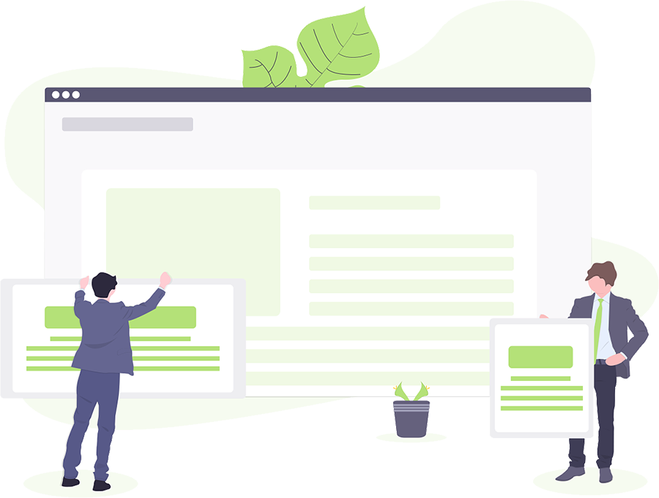
Business Rules
Automations
Triggers
Macros
Views

Slide 10
Automations
Automations define conditions and actions that modify ticket properties and optionally send email notifications to customers and agents. Automations execute when a time event occurs after a ticket property was set or updated
Automations are time-based; they take action when a time-event occurs, not immediately after a ticket is created or updated.
Automations do not run or fire on closed tickets.
Here are some uses for automations :
Notifying agents when an assigned ticket remains unresolved for x number of hours
Notifying agent groups when a new ticket remains unassigned for x number of hours
Notifying the assigned agent after x number of hours when a pending ticket has been updated by the requester
Closing tickets x number of days after they have been set to solved
Finding "abandoned" tickets that haven't been updated for a certain number of days

Slide 11
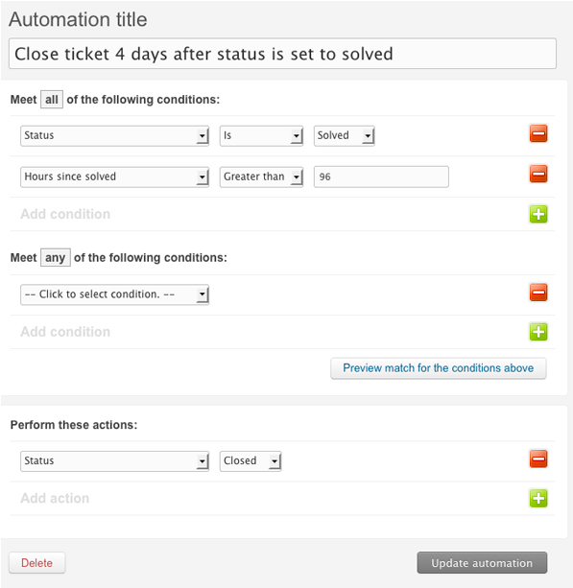
Automation Demo

Slide 12
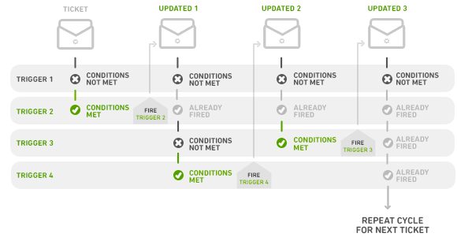
Triggers
Triggers are business rules you define to run immediately after tickets are created or updated. For example, a trigger can be used to notify the customer when a ticket has been opened. Another can be created to then notify the customer when the ticket is solved.
Triggers are created from conditions and actions. Conditions set the qualifications needed for the trigger to fire and actions represent what will be performed when those qualifications are met.
Triggers will run, or check the conditions, immediately after tickets are created or updated.
Triggers do not run or fire on tickets after they are closed. However, triggers can fire when a ticket is being set to closed.
Here are some uses for triggers :
Notifying customers when you're out-of-office
Sending customer satisfaction score follow-ups
Routing your priority customers to a specialised support group automatically
Adding and removing tags
For automated responses

Slide 13
Macros
Unlike triggers and automations, macros only contain actions, not conditions. Conditions aren't used because nothing is automatically evaluating tickets to determine if a macro should be applied. Agents evaluate tickets and apply macros manually as needed.Triggers are created from conditions and actions. Conditions set the qualifications needed for the trigger to fire and actions represent what will be performed when those qualifications are met.
Here are some uses for Macro :
Add comment text
Update ticket fields
Change the assignee
Reusable replies

Slide 14
Macros Demo

Slide 15
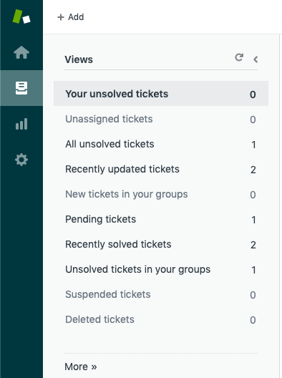
Views
Views are a way to organise your tickets by grouping them into lists based on certain criteria. For example, you can create a view for unsolved tickets that are assigned to you, a view for new tickets that need to be triaged, or a view for pending tickets that are awaiting response. Using views can help you determine what tickets need attention from you or your team and plan accordingly.Here are some uses for Macro :
Default views. There are a number of pre-defined views created when you open a Zendesk Support account. You can deactivate or edit most of these views; however, the Suspended tickets and Deleted tickets views cannot be edited or removed from your list of views.
Shared views. Administrators can create views that are available to all agents or to all agents in a specific group. The first 12 shared views are accessible in the Views list.
Personal views. Agents can create views that available to themselves only. The first 8 personal views are accessible in the Views list

Slide 16


Groups
Groups are used to create collections of agents based on criteria those agents have in common. All agents must belong to at least one group, and they can belong to multiple groups.
After you create an agent you can add them to either pre-existing groups or assign them to new groups.

Slide 17
Our Protocol
Explains How we have implemented it on our system.

Slide 18
Our Configuration Of Zendesk
Owner
raja@quickbit.eu
Default Email
tech.support@quicbit.eu
Groups
- Admins
Raja (raja@quickbit.eu)
- Tech Support
Tech Support (tech@quickbit.eu)
Awais (awaisaqeel.devco@gmail.com)
- Admin
Raja (raja@quickbit.eu)
- Agents
Tech Support (tech@quickbit.eu)
Awais (awaisaqeel.devco@gmail.com)
Support Emails
tech.support@quicbit.eu
suppor@quickbit.zendesk.com

Slide 19
Thanks

